Slide 1
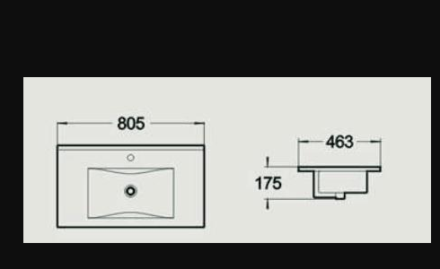
FICHE TECHNIQUE – LAV575
Date : 20/04/21

